Slide 1
GENETIC ALGORITHMS
Course Code: CSC4226
Course Title: Artificial Intelligence and Expert System
Dept. of Computer Science
Faculty of Science and Technology
Lecture No: | Five (5) | Week No: | Five (5) | Semester:
Lecturer: | Dr. Ashraf Uddin dr.ashraf@aiub.edu

Slide 2
Lecture Outline
What are GA’s ?
Biological Background.
Basic Genetic Algorithm.
Encoding.
Operators of GA.
Example Problem.

Slide 3
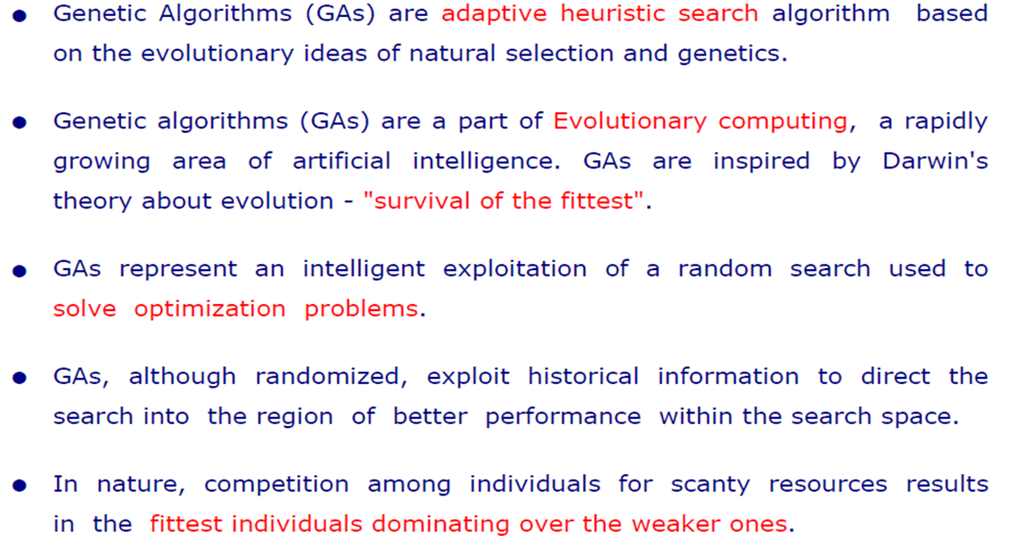
What are GAs?

Slide 4
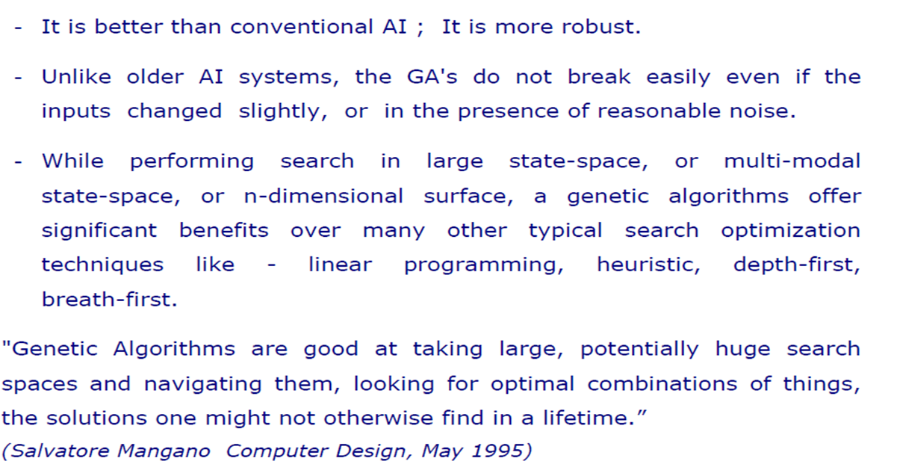
WHY GA?

Slide 5
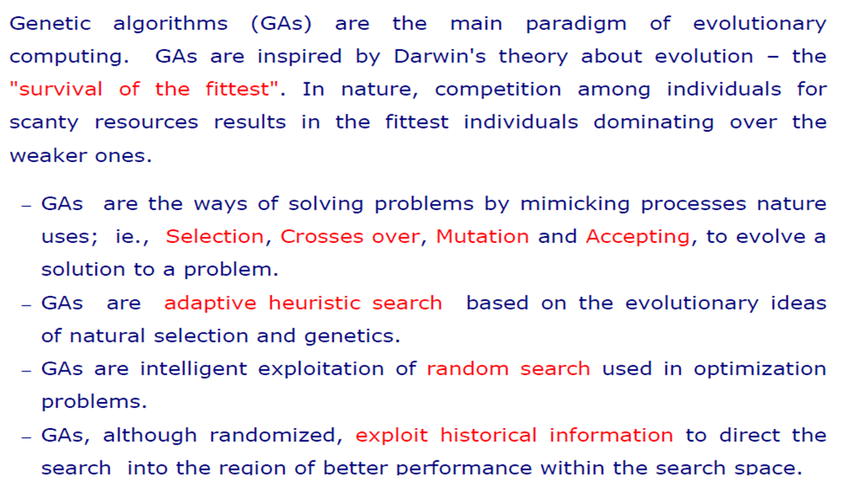
GA: BASIC CONCEPT

Slide 6
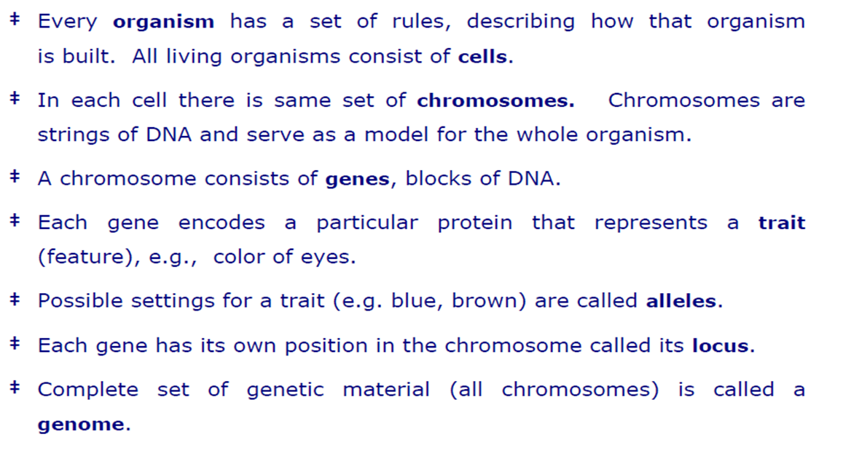
BIOLOGICAL BACKGROUND

Slide 7
BIOLOGICAL BACKGROUND

Slide 8
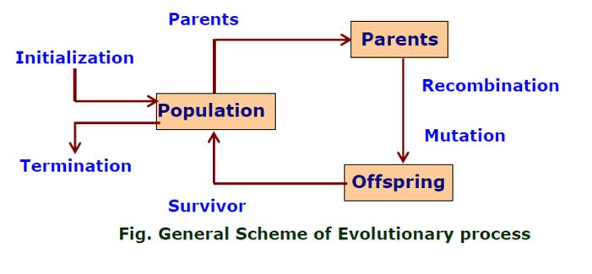
GA: FLOW-CHART

Slide 9
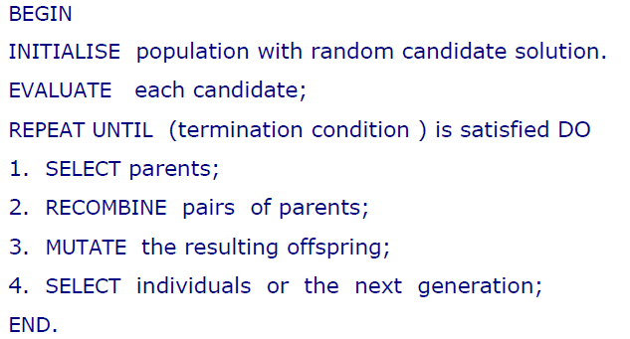
GA: PSEUDO-CODE

Slide 10
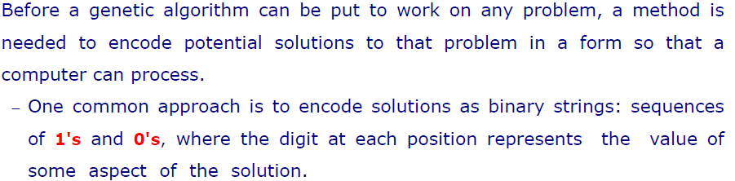
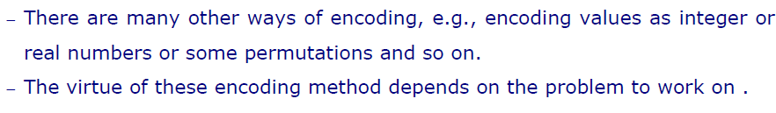
ENCODING

Slide 11
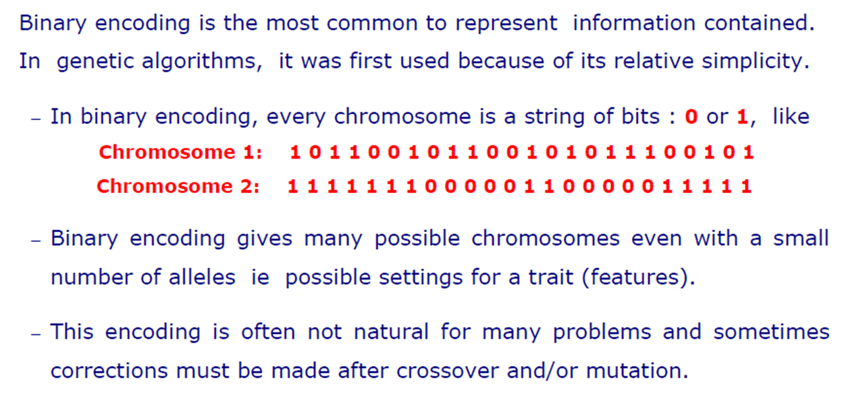
BINARY ENCODING

Slide 12
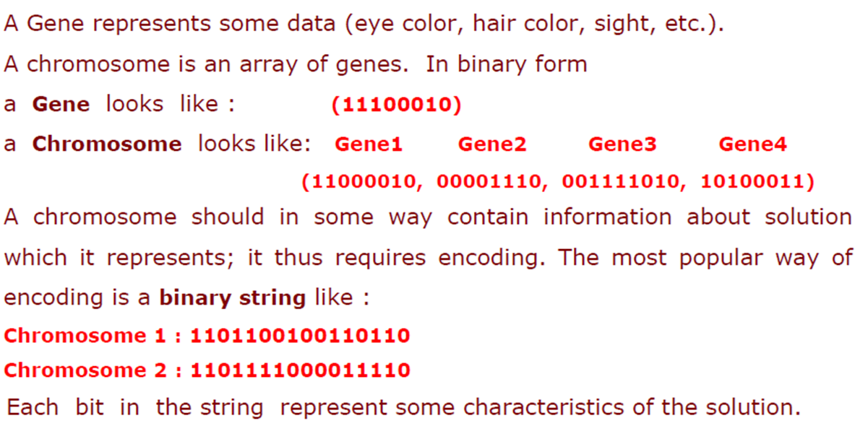
Example: Binary Encoding

Slide 13
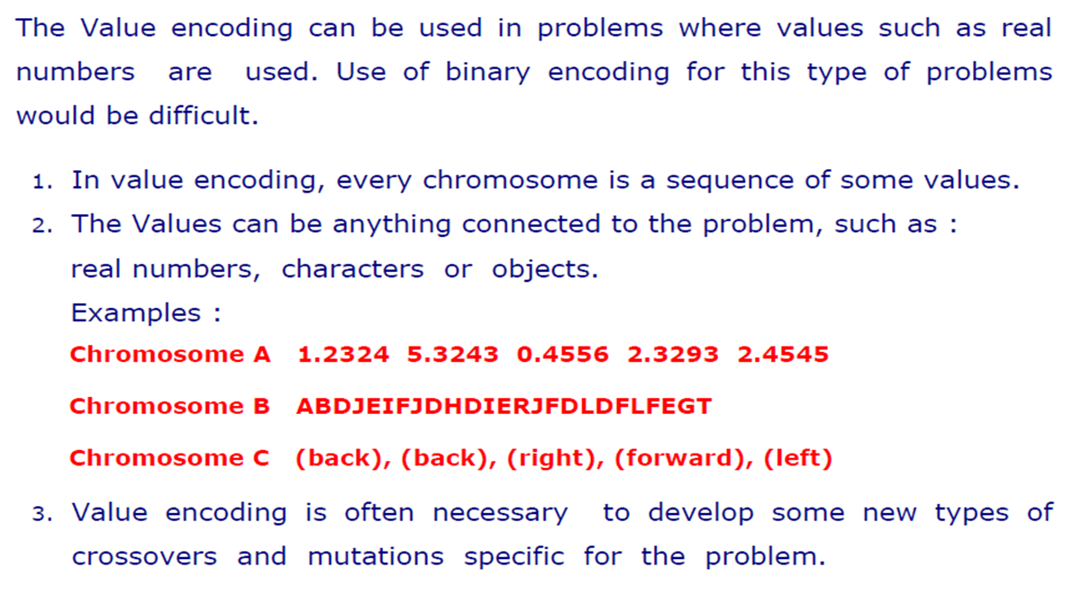
Value Encoding

Slide 14
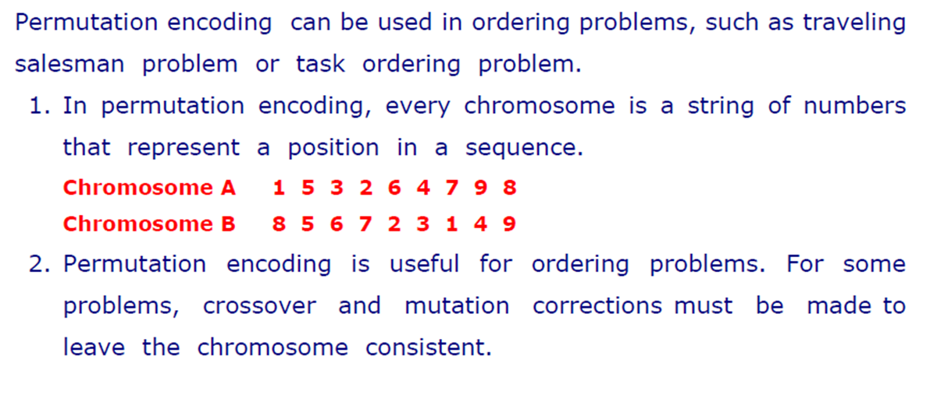
Permutation Encoding

Slide 15
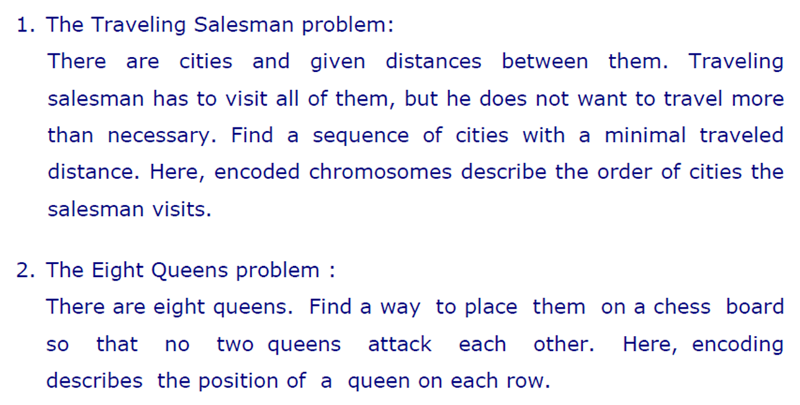
Examples: Permutation Encoding

Slide 16
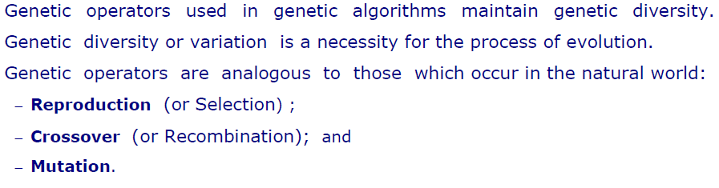
Operators of GA

Slide 17
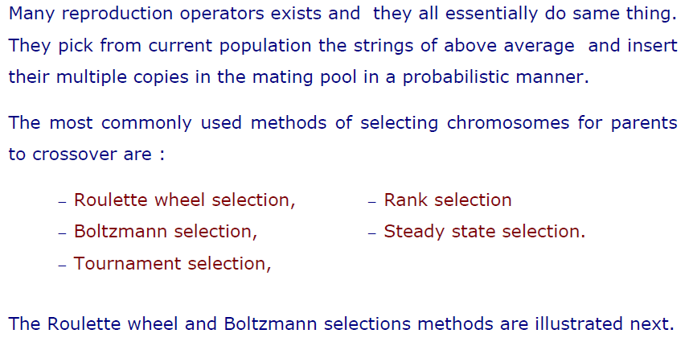
Selection

Slide 18
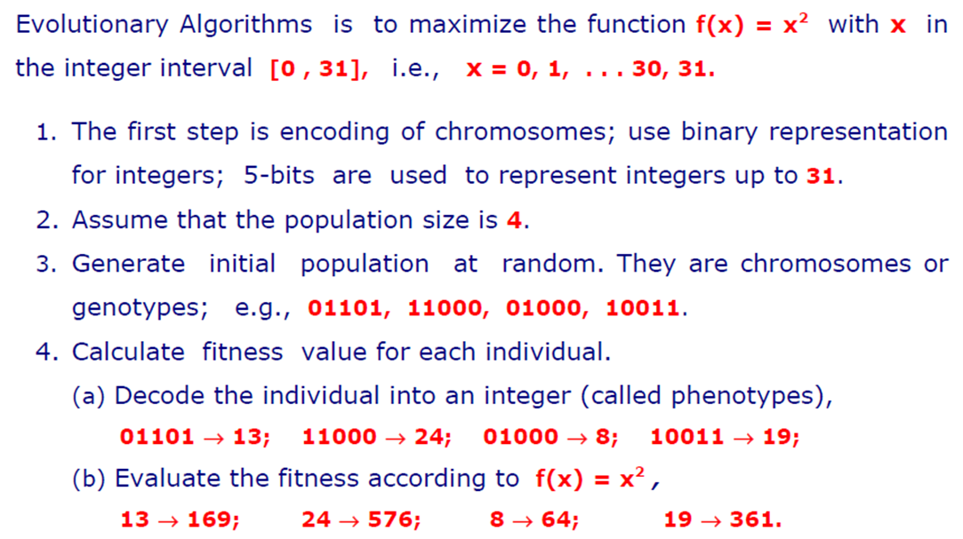
Example of Selection

Slide 19
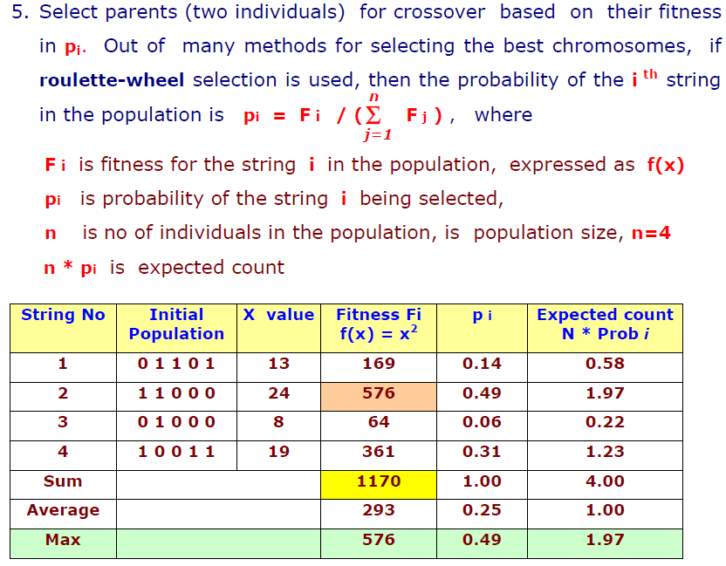
Example of Selection

Slide 20
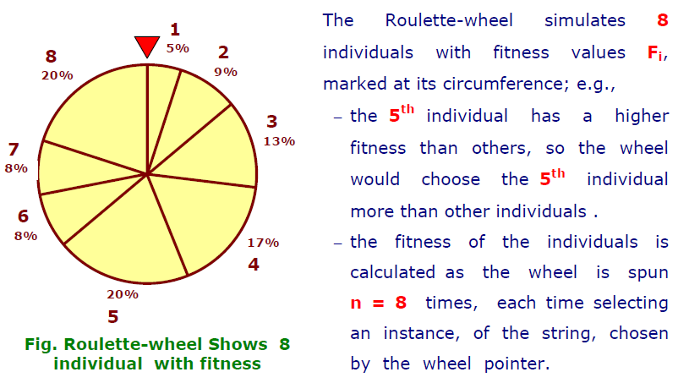
Roulette Wheel Selection

Slide 21
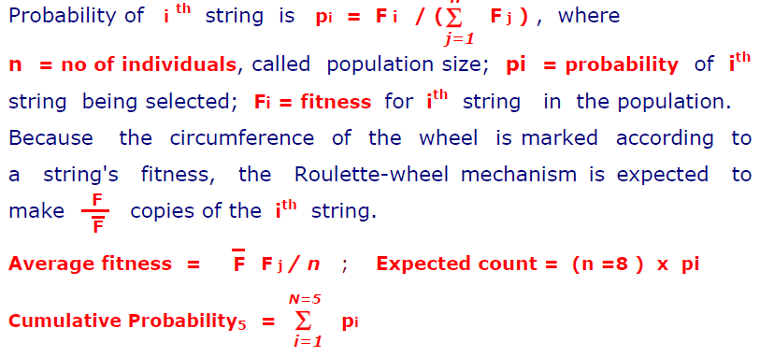
Roulette Wheel Selection

Slide 22
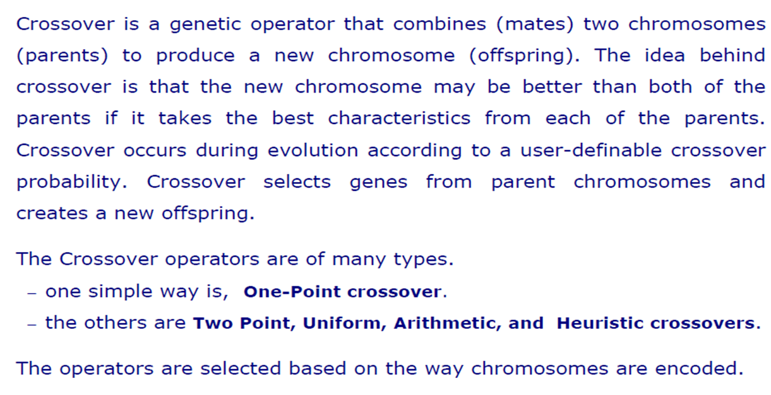
Crossover

Slide 23
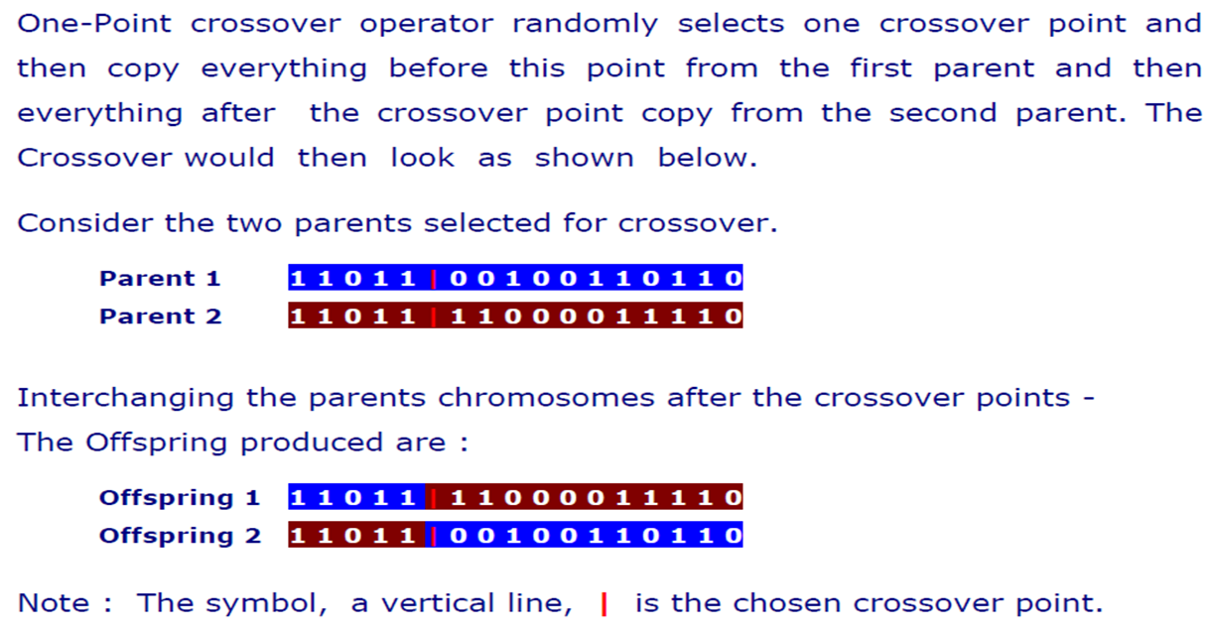
One-Point Crossover

Slide 24
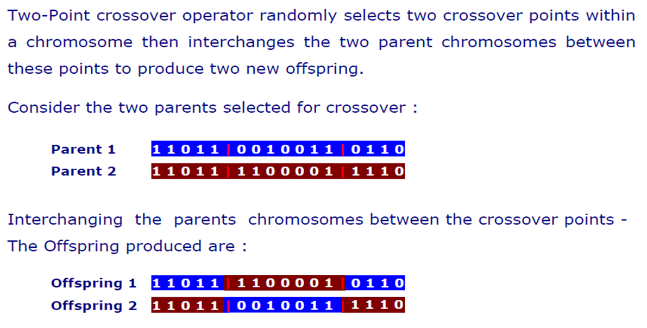
Two-Point Crossover

Slide 25
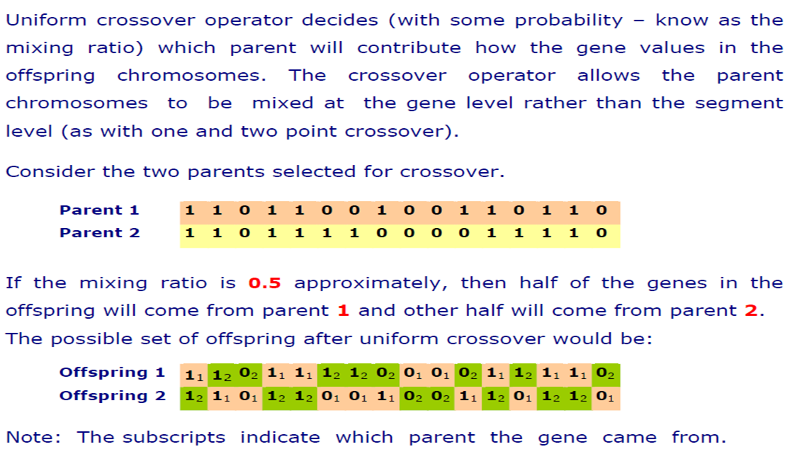
Uniform Crossover

Slide 26
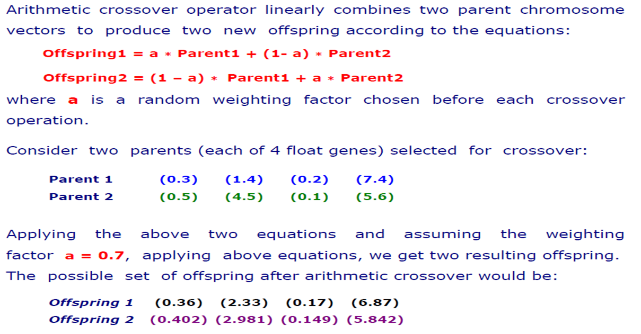
Arithmetic Crossover

Slide 27
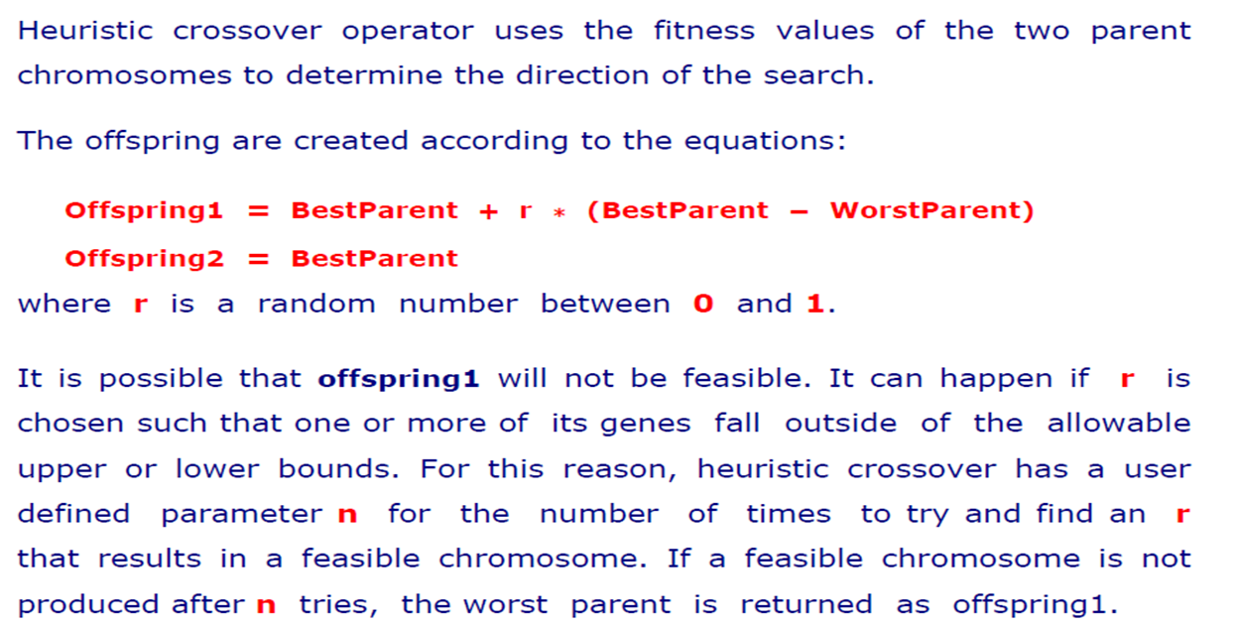
Heuristic Crossover

Slide 28
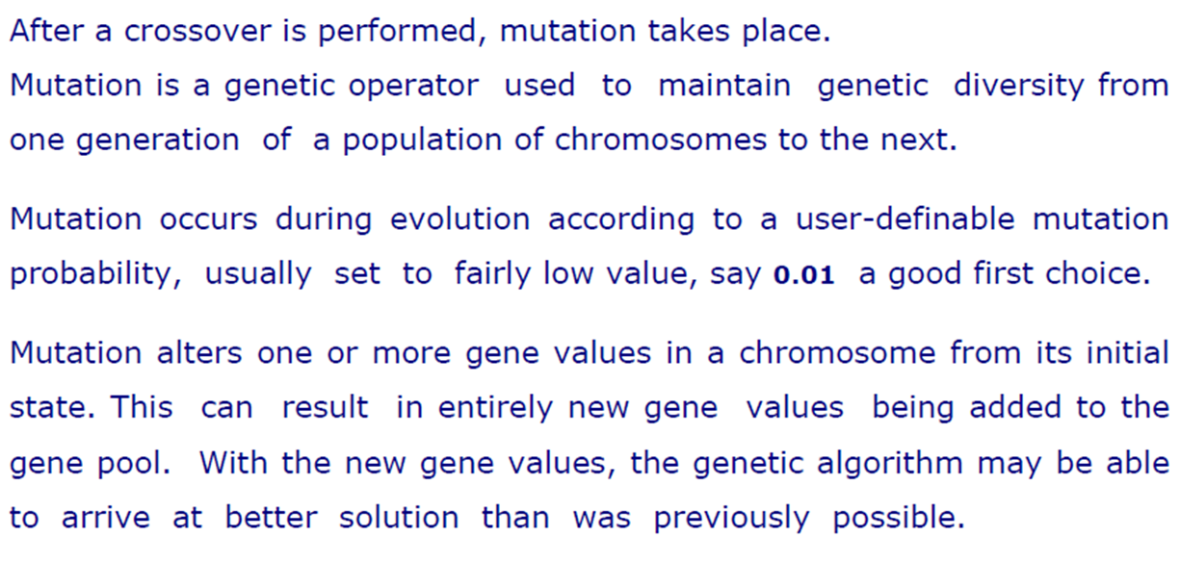
Mutation

Slide 29
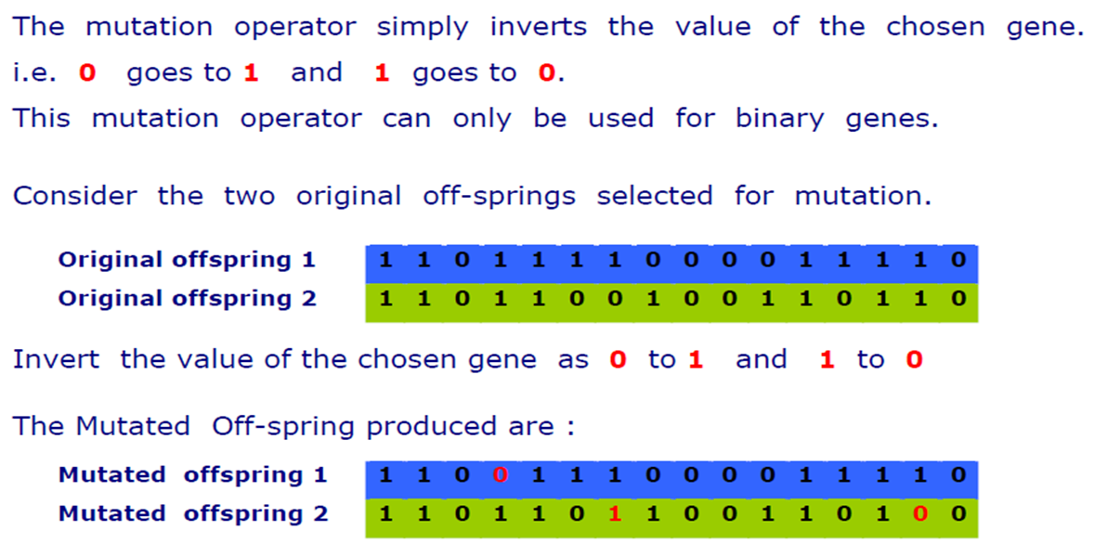
Flip Bit Mutation

Slide 30
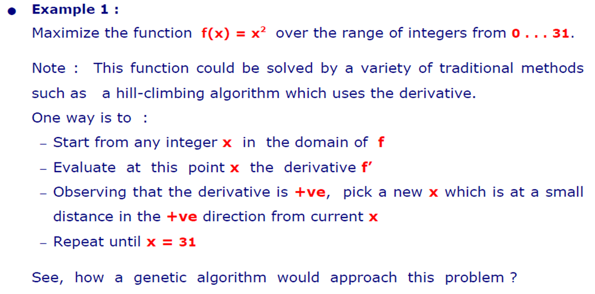
Demonstration

Slide 31
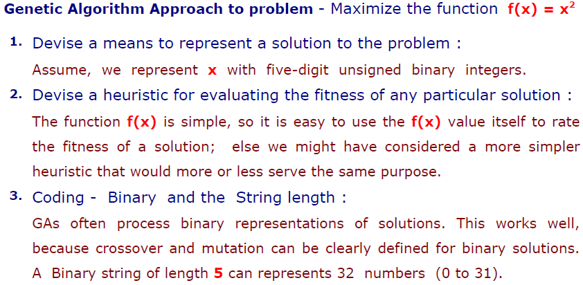
GA Approach

Slide 32
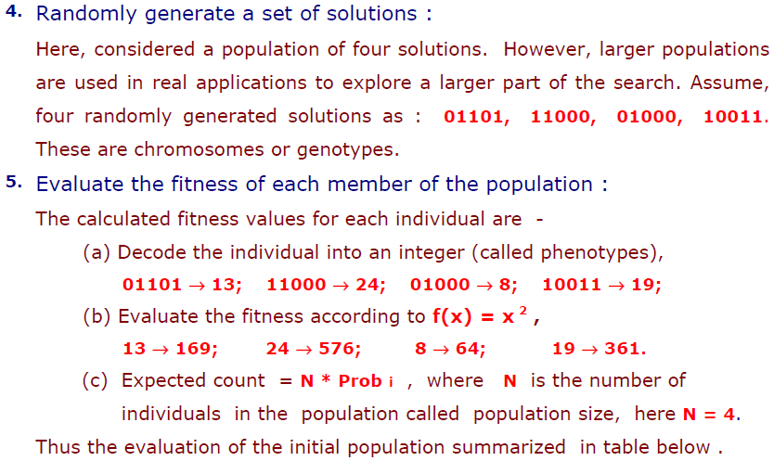
GA Approach

Slide 33
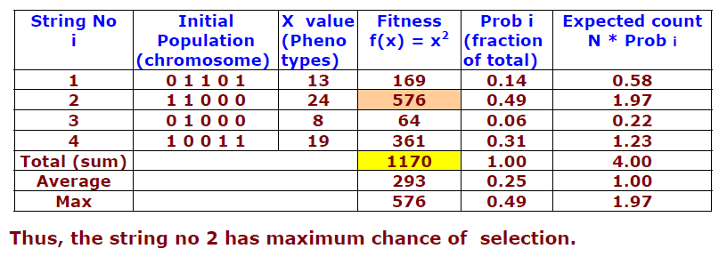
Calculating Fitness & Probability

Slide 34
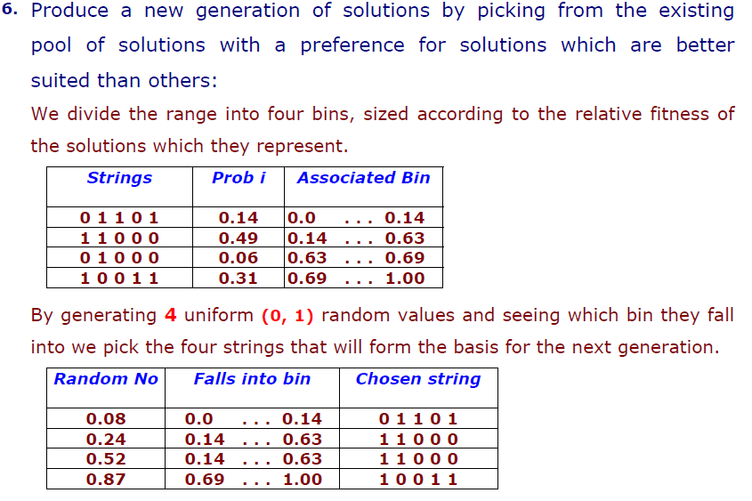
Selection

Slide 35
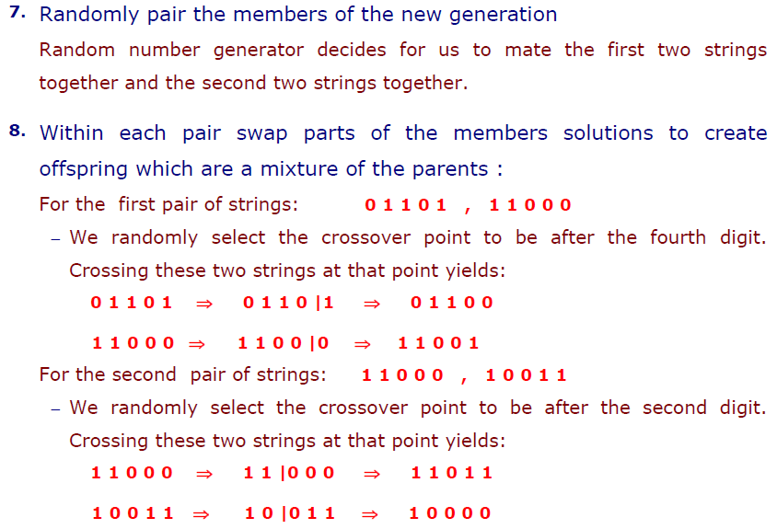
Crossover

Slide 36
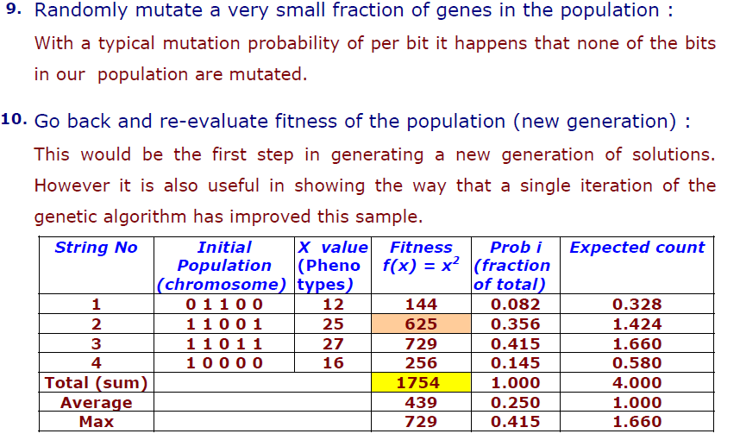
Mutate & Re-evaluate

Slide 37
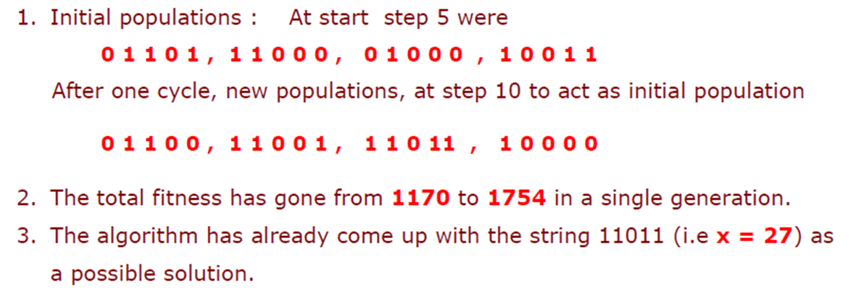
Improved: Individual & Total Fitness

Slide 38
References
“Practical Genetic Algorithms,” by Randy L. Haupt and Sue Ellen Haupt.

Slide 39
Books
“Artificial Intelligence: A Modern Approach,” by Stuart J. Russell and Peter Norvig.
"Artificial Intelligence: Structures and Strategies for Complex Problem Solving", by George F. Luger, (2002)
"Artificial Intelligence: Theory and Practice", by Thomas Dean.
"AI: A New Synthesis", by Nils J. Nilsson.
“Programming for machine learning,” by J. Ross Quinlan,
“Neural Computing Theory and Practice,” by Philip D. Wasserman, .
“Neural Network Design,” by Martin T. Hagan, Howard B. Demuth, Mark H. Beale, .
“Practical Genetic Algorithms,” by Randy L. Haupt and Sue Ellen Haupt.
“Genetic Algorithms in Search, optimization and Machine learning,” by David E. Goldberg.
"Computational Intelligence: A Logical Approach", by David Poole, Alan Mackworth, and Randy Goebel.
“Introduction to Turbo Prolog”, by Carl Townsend.

